Slide 1
GA SF: Data Science Immersive

Slide 2










Instructional Team
Vrushank
Alexander
Varsha

Slide 3
Introductions
Why are you spending the next 3 months at General Assembly?
Beyond technical skills, how do you want to grow in the next 3 months?
What is one thing that you believe is possible that others believe is impossible?

Slide 4
Data Products
What is a Data Product?

Slide 5
Data Products
In sixty seconds, write down all of the data products you use.

Slide 6
Data Products
Data Products process, analyze, and model data to:
Drive Decisions, e.g. Amazon’s Rec Engine
Automate complex tasks, e.g. Self-driving cars
Uncover hidden patterns, e.g. Deep Learning for Genomics

Slide 7
“Programs are not just algorithms as concepts or applied ideas. They are algorithms in motion. Code is uniquely kinetic. It acts and interacts with itself, with the world. In code, the mental and the material are one. Code moves. It changes the world.” Vikram Chandra, Geek Sublime

Slide 8
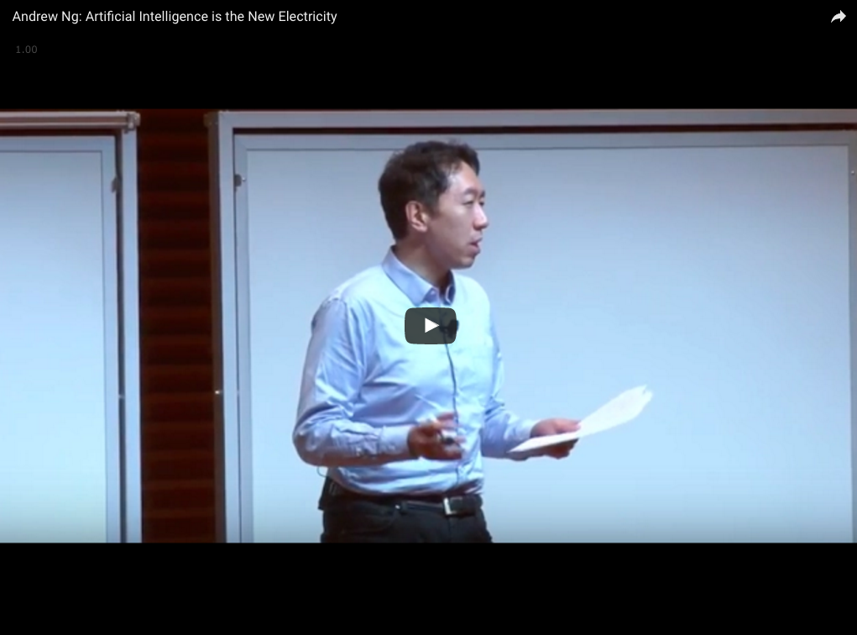
“AI is the new electricity.” – Andrew Ng

Slide 9
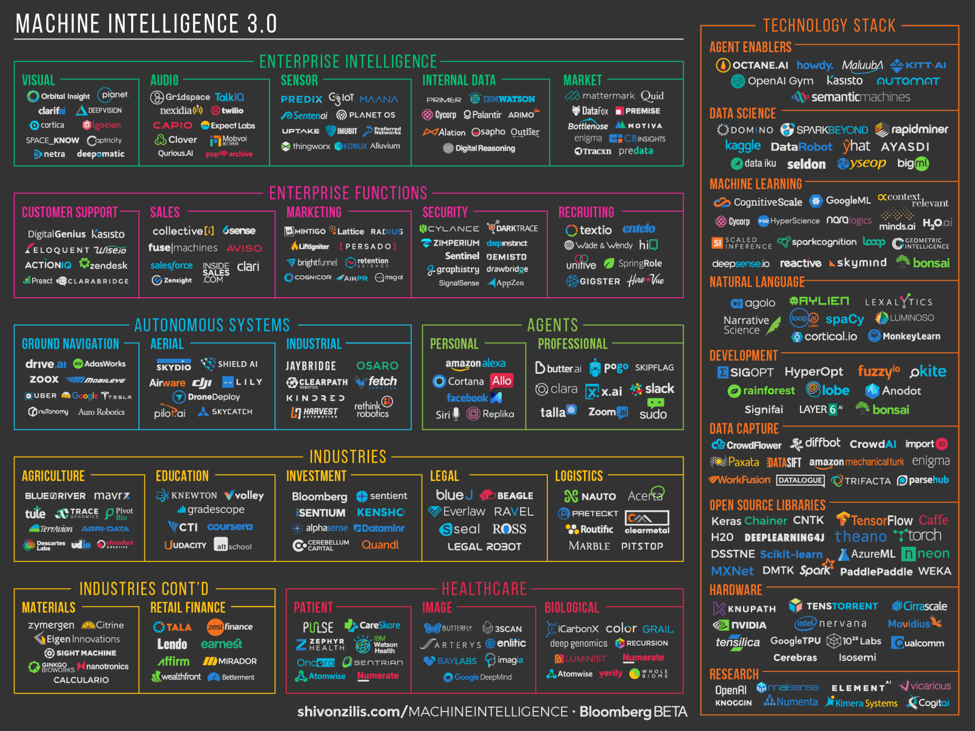

Slide 10
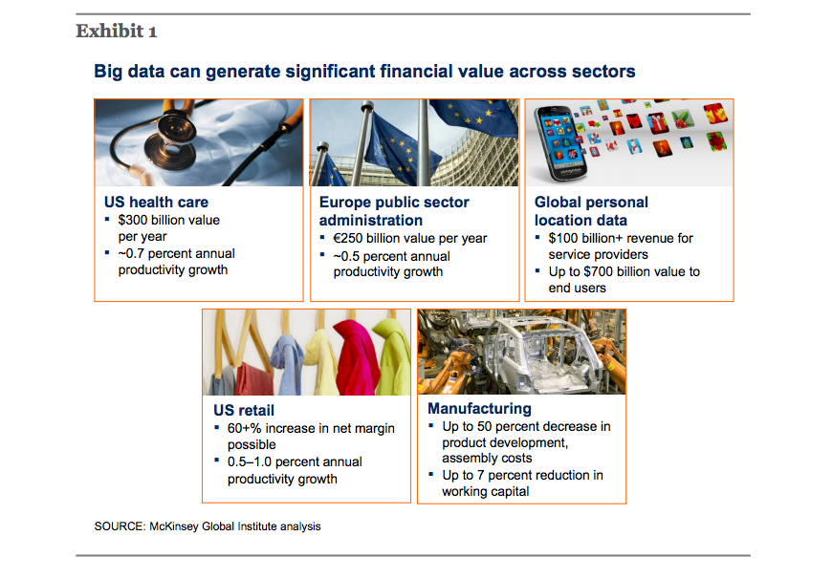

Slide 11
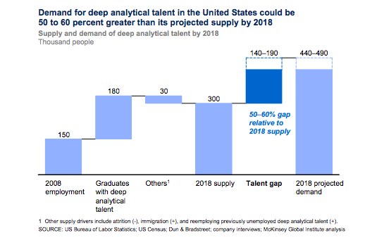

Slide 12
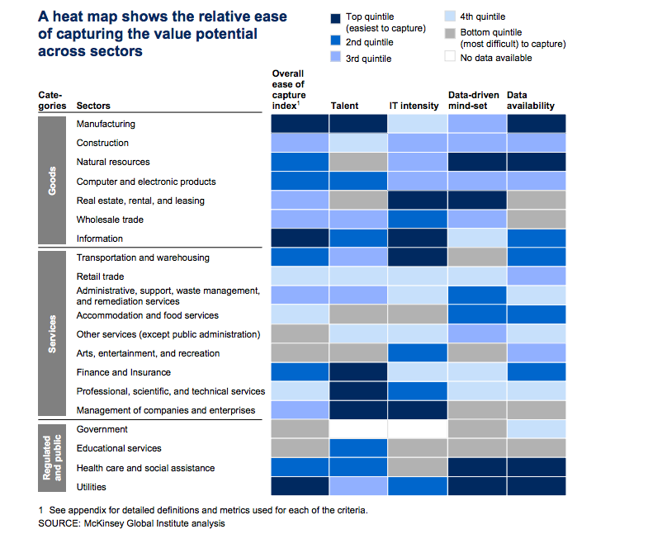

Slide 13
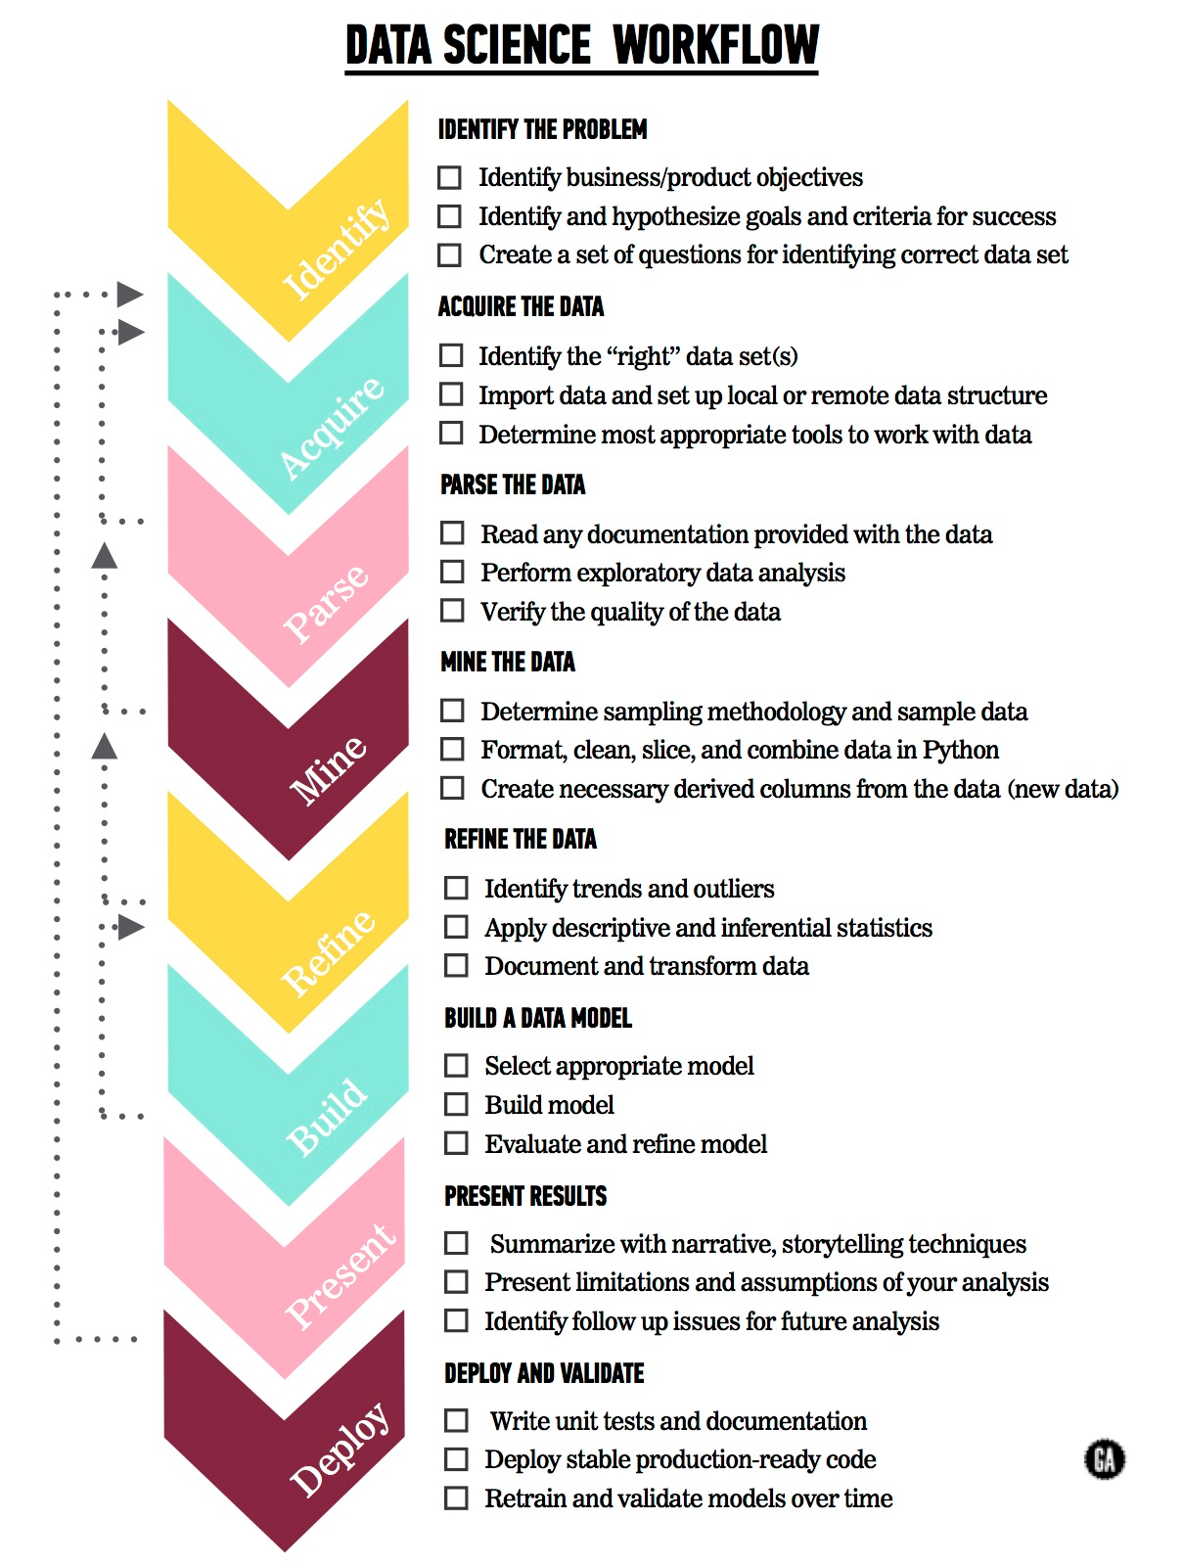
Data Science: Process
Notes:
Charlie voiceover

Slide 14
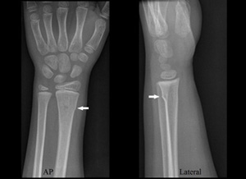
DATA SCIENCE: PROCESS
 | Identify the Problem | Acquiring the Data | Parse the Data | Mine the Data | Refine the Data | Build a Data Model | Present and Evaluate Results | Deploy and Validate Results
Skills | Business Acumen, Product Focus | Relationship building, Software Engineering | Software Engineering | Statistics, SWE | Statistics, Machine Learning | Machine Learning | Statistics, Common Sense | SWE
Example | Radiologists are not keeping up with the pace at which medical images are being created. | Create partnerships with hospitals. Still need to take data out from old school infrastructure. | Make sure the quality of the X-ray images is high. | Sample a small portion of 100mil images to prototype algorithms. | Make sure sample of X-ray images is representative of the broader population. | Build a CNN to diagnose fractures. | Models achieve super human level accuracy. | Deploy model to the cloud to predict on future data.

Slide 15
Machine Intelligence in Industry
Across your industry:
Identify the Problems: What problems are important to solve? Why are they important? What kind of value can they generate?
Data: What kind of datasets are being collected or can be collected? Why is it easier to collect these datasets now? How do these datasets help solve important problems or answer useful questions in the industry?
Modeling Case Studies: What modeling approaches are being used to solve these problems?
People: Who are the main thought leaders, companies, and innovators in this industry that deploying Machine Learning to solve important business problems?
Barriers: What are the common barriers that enterprises face in capturing value from their data in this industry?

Slide 16
Data Science Immersive: Schedule
1 | Engineering and Python Foundations | Data Acquisition, Data Engineering
2 | Linear Algebra, Statistics | Evaluate Results
3-6 | Machine Learning, Natural Language Processing, Deep Learning for Computer Vision | Build Models, Evaluate Results
5-7 | Web Scraping, APIs, Flask | Data Acquisition, Deployment
8 | Big Data (Spark, Hadoop), Databases | Data Storage, Data Deployment
9 | Recommender Systems, A/B Testing and Multi-Armed Bandits | Model Evaluation and Validation, End to End Data Products
10-12 | Deep Learning for QA, Capstone | End to End Data Products

Slide 17
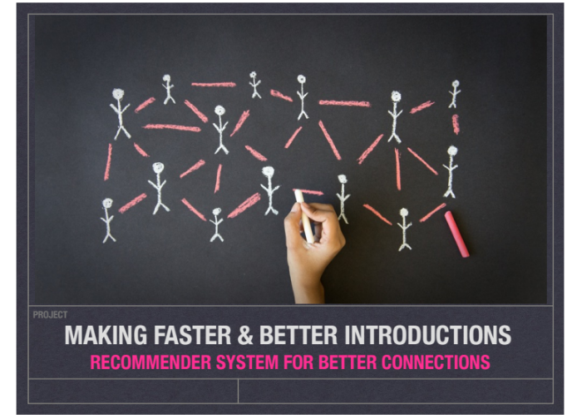
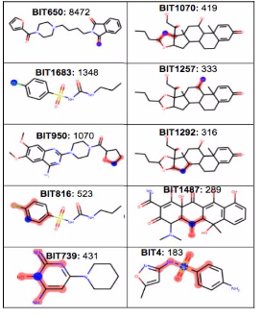
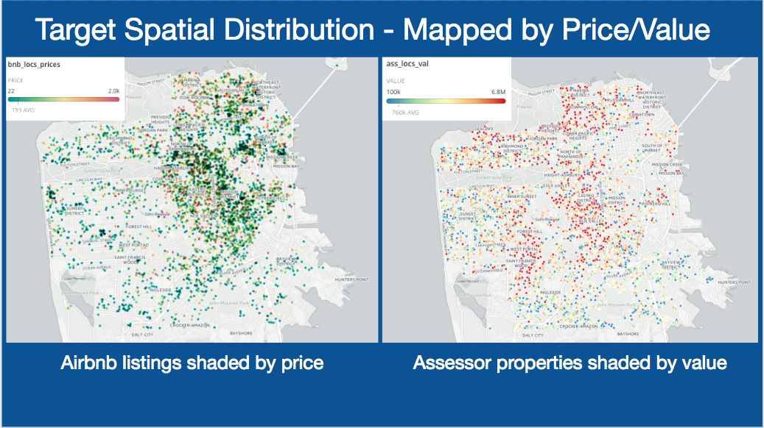
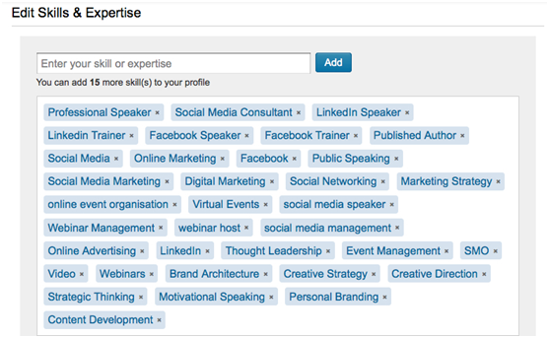
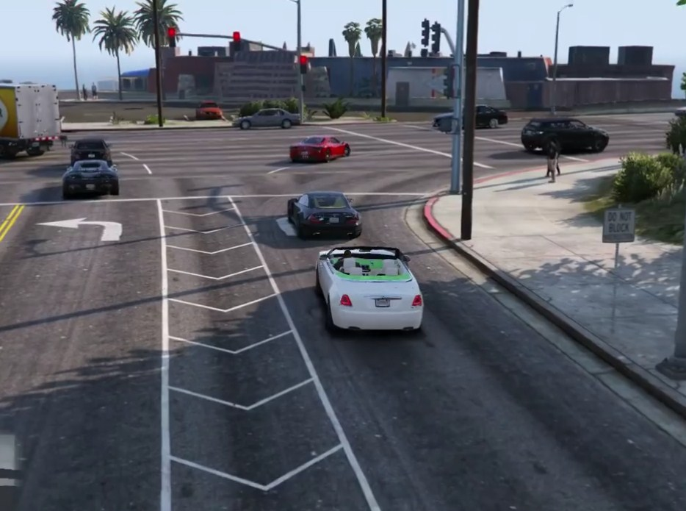
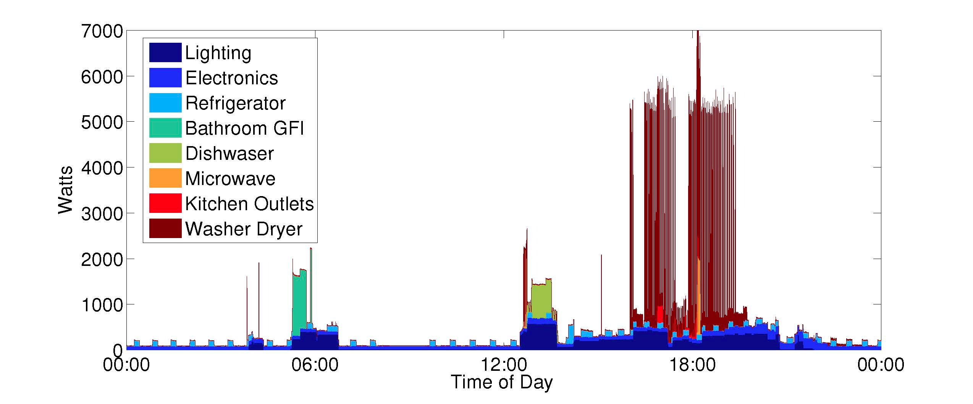
Data Science Immersive: Capstone

Slide 18
Questions?

